Slide 1

Universal Redaction Model
Next-Gen Intelligent Data Loss Prevention
Team: Super Saiyans
Debojyoti Singha
Md. Joynal Abedian
Fardin Hasan Mayen

Slide 2

The Silent Threat: Data Leakage Risks
Unstructured data, such as emails, logs, and reports, often harbour Personally Identifiable Information (PII), creating significant vulnerabilities. This poses critical risks, including identity theft, non-compliance with regulations like GDPR and CCPA, and potential corporate espionage.
Did you know?
80% of data is unstructured and notoriously difficult to secure.

Slide 3
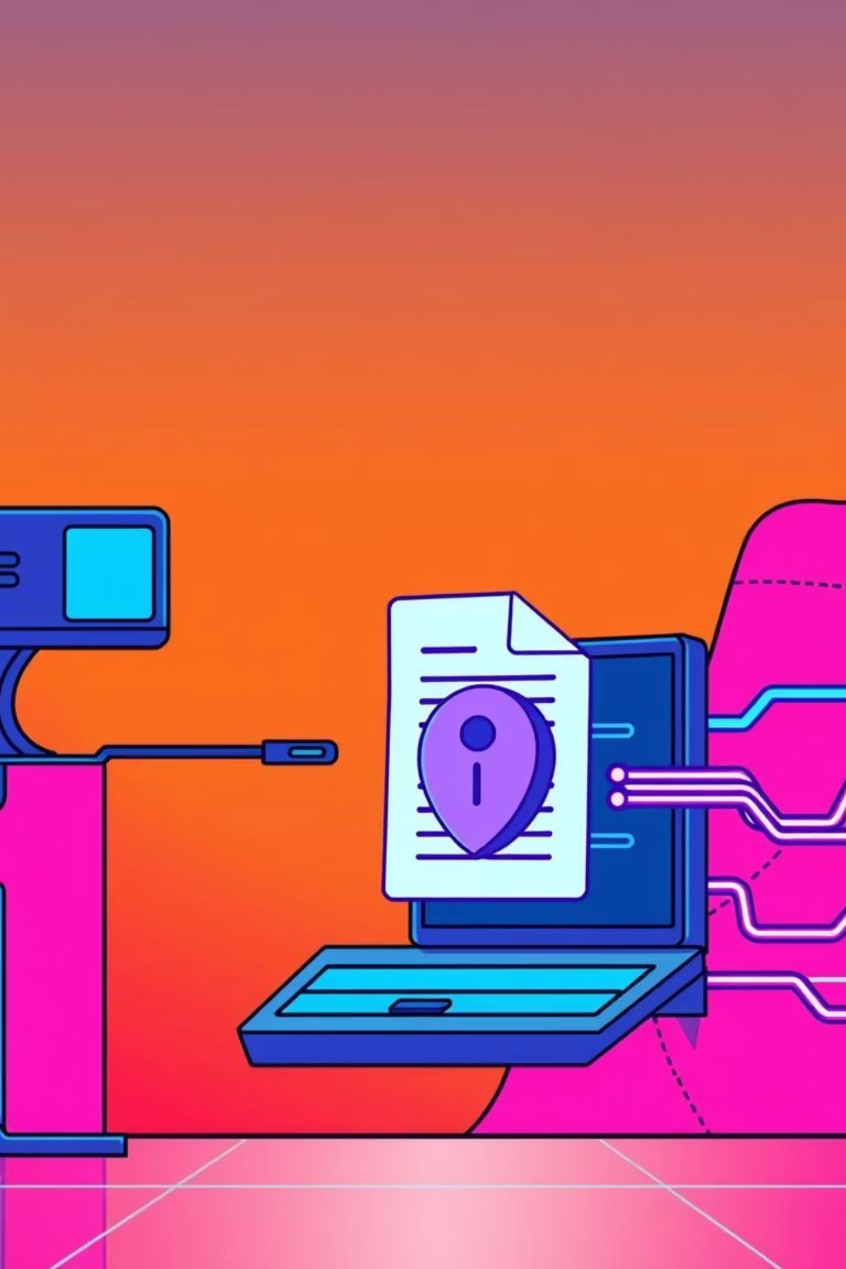
Introducing the Universe Redaction Tool
Our innovative system moves beyond mere pattern matching (Regex), employing advanced Large Language Models (LLMs) to genuinely understand the context of your data. This intelligent approach allows for precise and effective data protection.
Intelligent Redaction
Precision & Privacy
Context-aware data identification.
Balancing data utility with stringent privacy requirements.
Beyond Patterns
Utilises LLMs for deeper contextual understanding.

Slide 4












Core Technology & Architecture
Our solution is built on a robust and modern technology stack, ensuring speed, scalability, and an intuitive user experience.
Frontend
AI Engine
React, TypeScript, Tailwind CSS
Google Gemini 2.5 Flash
Workflow
Workflow
Output Secured Data
Input Text
Workflow
Workflow
Context-Aware Redaction
AI Analysis

Slide 5





Key Features Overview
The Universe Redaction Tool offers a comprehensive suite of features designed for unparalleled data protection.
Smart Entity Detection
Identifies persons, locations, IP addresses, credit card numbers, and other sensitive information with high accuracy.
Dual Redaction Modes
Choose between masking (e.g., [NAME]) for clear placeholders or complete redaction (whitespace) for maximum privacy.
Live Evaluation
Real-time accuracy scoring against ground truth ensures immediate feedback and continuous improvement.
Modern UI/UX
Intuitive dark and light themes with responsive design for seamless user interaction across devices.

Slide 6

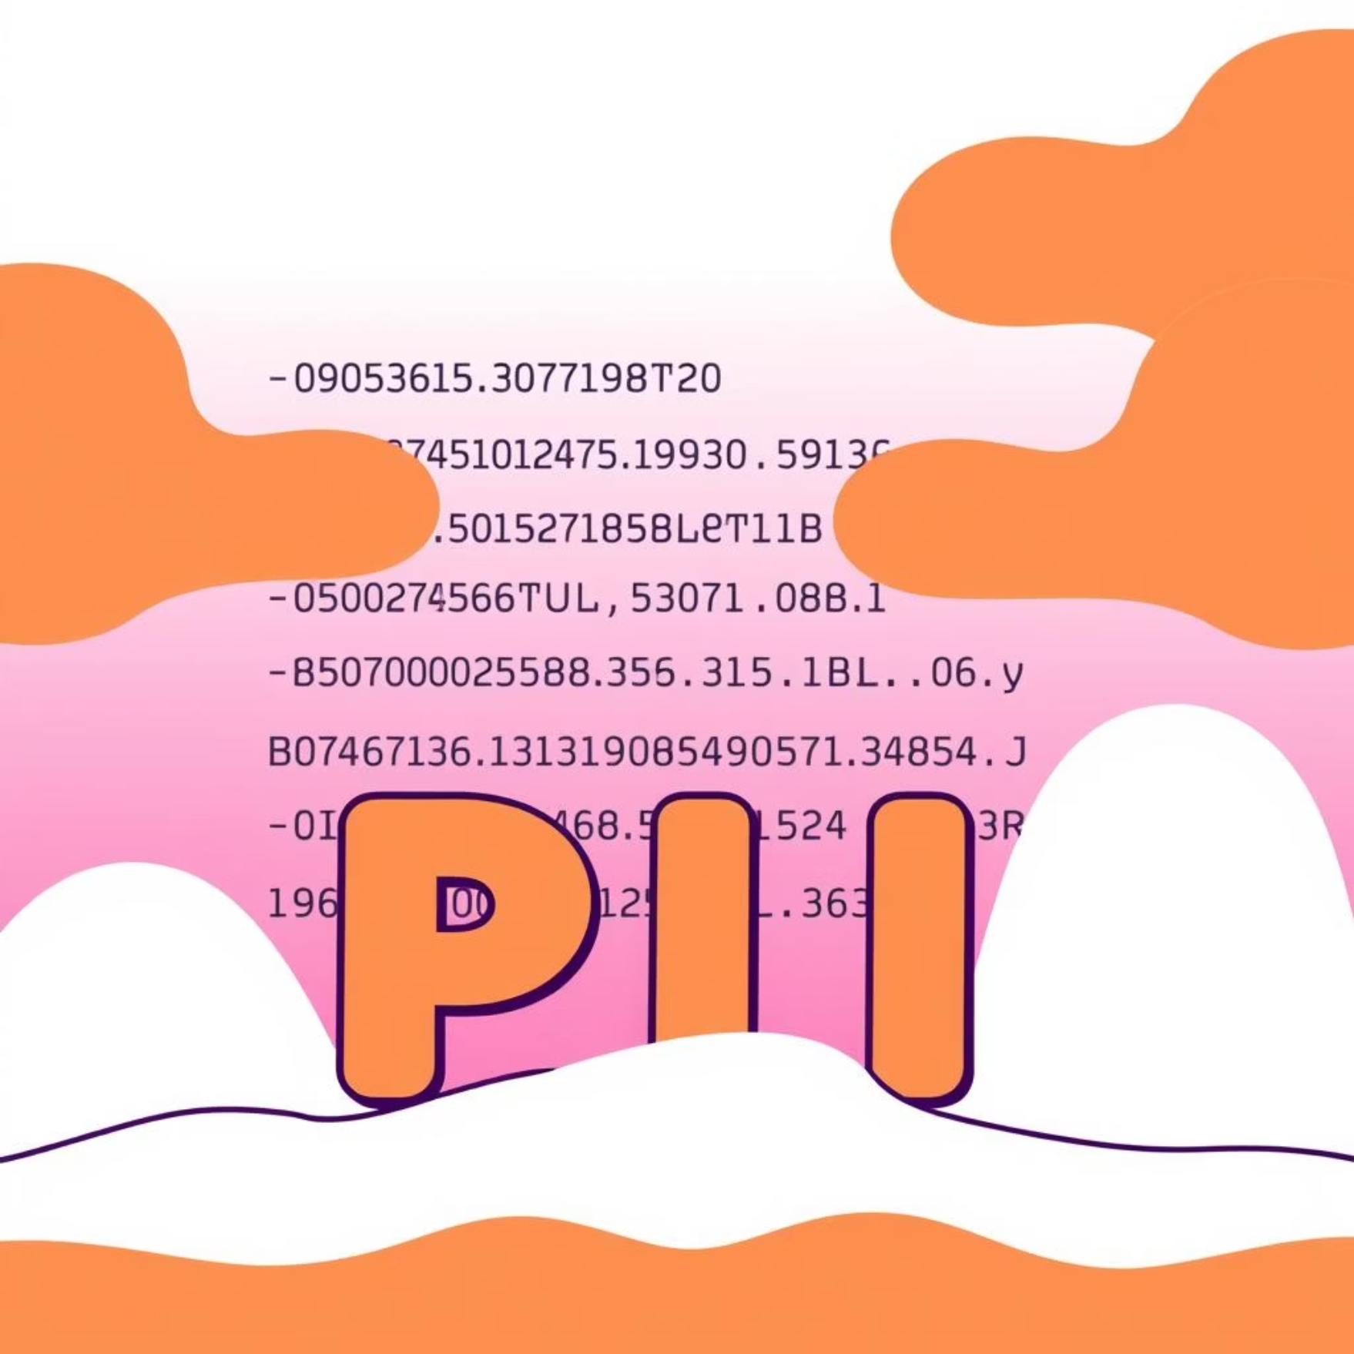
Demo: Unveiling Detection Logic
After Redaction
Witness the power of context-aware redaction in action with a clear before-and-after example.
"Please contact [PERSON] at [PHONE_NUMBER] in [LOCATION] for further details regarding the project."
Before Redaction
Notice how prepositions like "at" or "in" are intelligently ignored, showcasing our system's advanced contextual understanding.
"Please contact John at 555-0199 in New York for further details regarding the project."

Slide 7
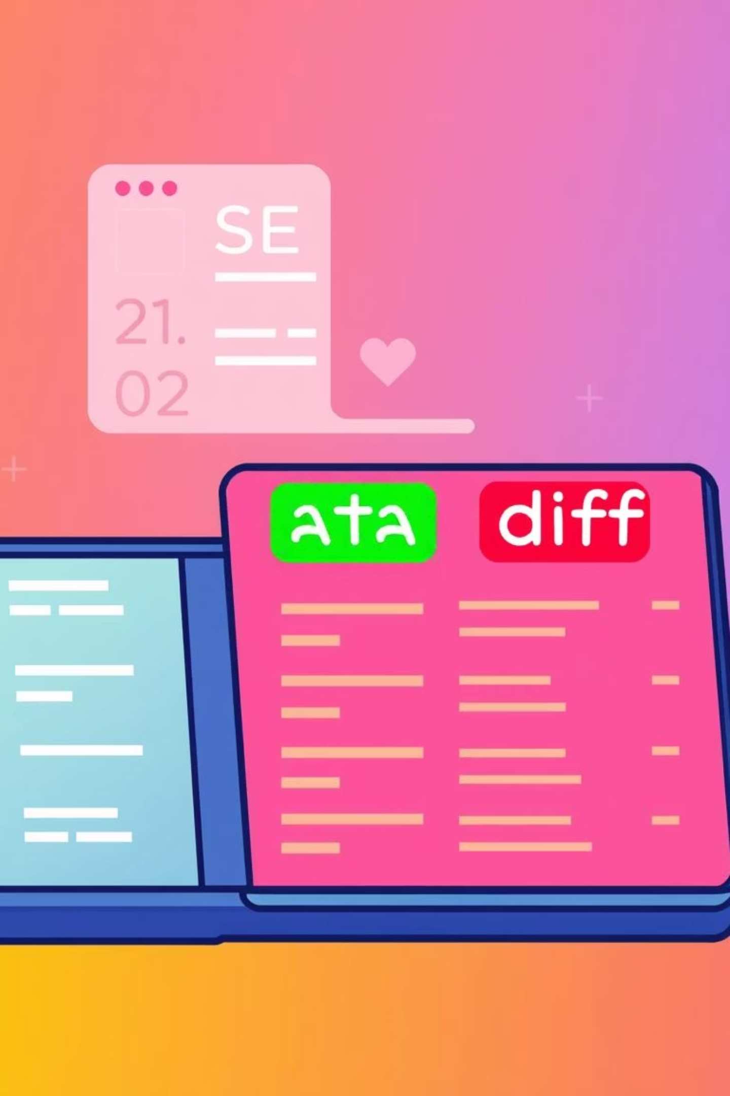




Evaluation Methodology: Measuring Success
Our success is quantified through a robust evaluation framework, ensuring high precision and reliability of our redaction processes.
Levenshtein Similarity Distance
A key metric used to quantify the accuracy and effectiveness of our redaction against ground truth.
Diff View Concept
Visually highlights redaction efficacy: green for perfect matches, red for any discrepancies or mismatches.

Slide 8

Overcoming Technical Challenges
Developing a sophisticated redaction tool presents unique technical hurdles, each met with innovative solutions.
Challenge 1: Over-Redaction
The risk of removing non-sensitive, context-critical words such as "at" or "by", impacting readability.
Solution: Refined System Instructions
Through meticulous prompt engineering, we've fine-tuned our LLM to understand and preserve linguistic nuances.
Challenge 2: Whitespace Inconsistencies
Variations in whitespace could erroneously affect similarity scores and hinder accurate evaluation.
Solution: Normalization Algorithms
We implement advanced normalization algorithms to standardise text formats before scoring, ensuring accurate metrics.

Slide 9
Business Impact & Use Cases
The Universe Redaction Tool brings significant value across various sectors, ensuring data privacy and operational efficiency.
Legal Document Scrubbing
Customer Support Ticket Anonymisation
Public Record Release
Automate the anonymisation of sensitive information in legal texts, ensuring compliance and confidentiality.
Facilitate the secure release of public information by redacting sensitive PII, upholding transparency and privacy.
Safeguard customer data in support logs, enabling analysis without compromising individual privacy.

Slide 10
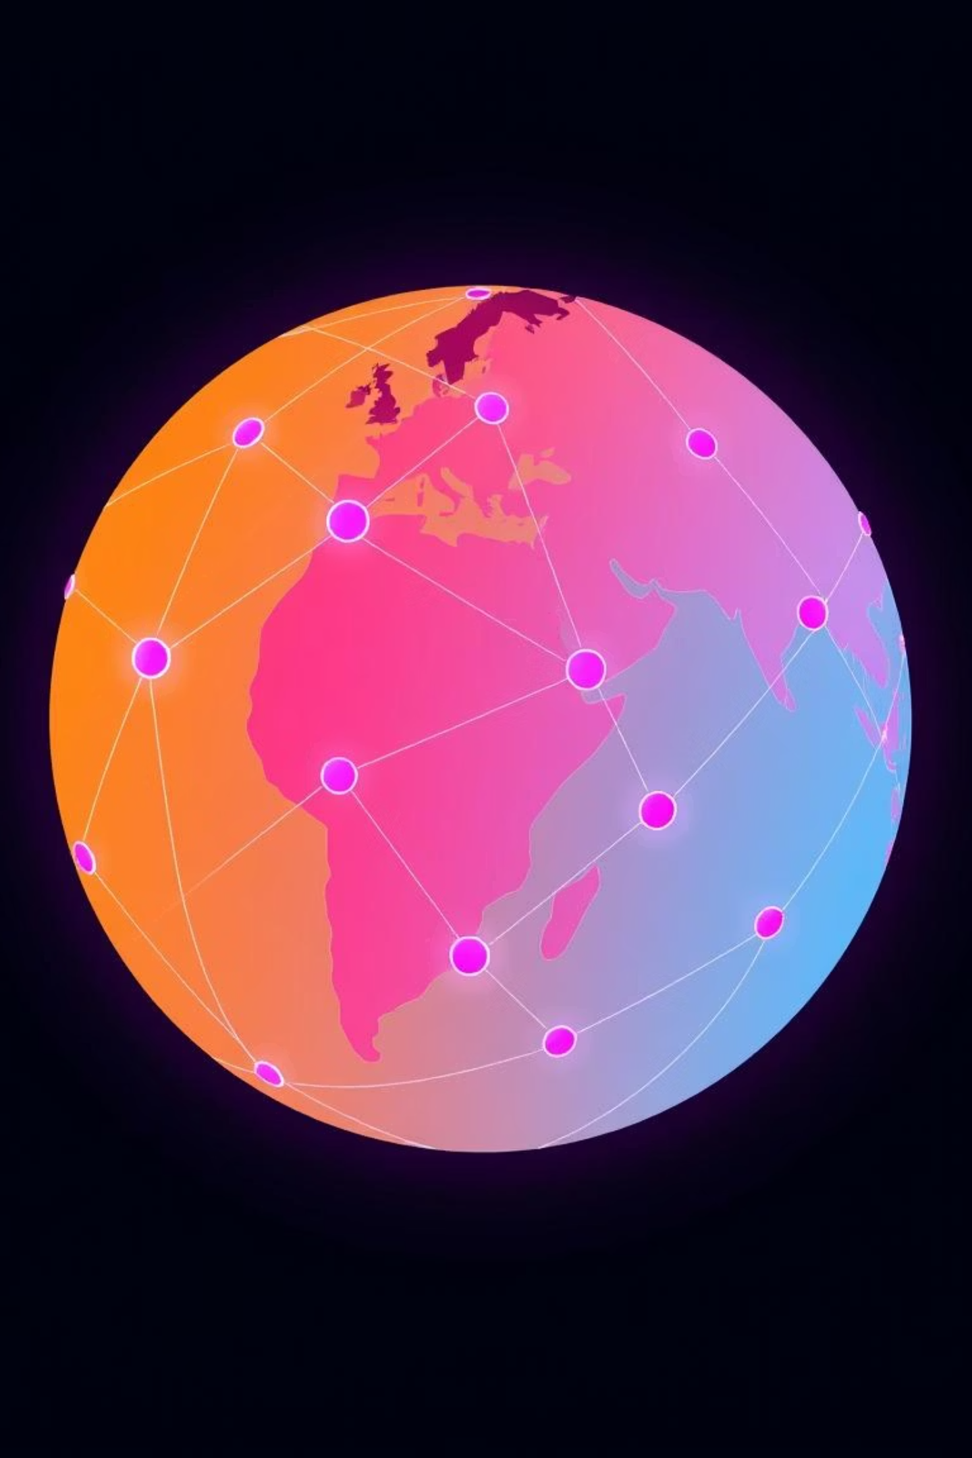





Future Roadmap & Call to Action
Our journey of innovation continues, with exciting developments on the horizon for the Universe Redaction Tool.
PDF/OCR Support
Expanding capabilities to include scanned documents and PDFs, ensuring comprehensive data coverage.
Customisable Entity Types
Allowing users to define and detect specific entity types, such as bespoke Medical IDs or project codes.
On-Device Local LLM
Integrating local LLM support for offline functionality, enhancing privacy and reducing latency.
Check out our live demo and explore the "Universe" design philosophy on GitHub!

